Slide 1
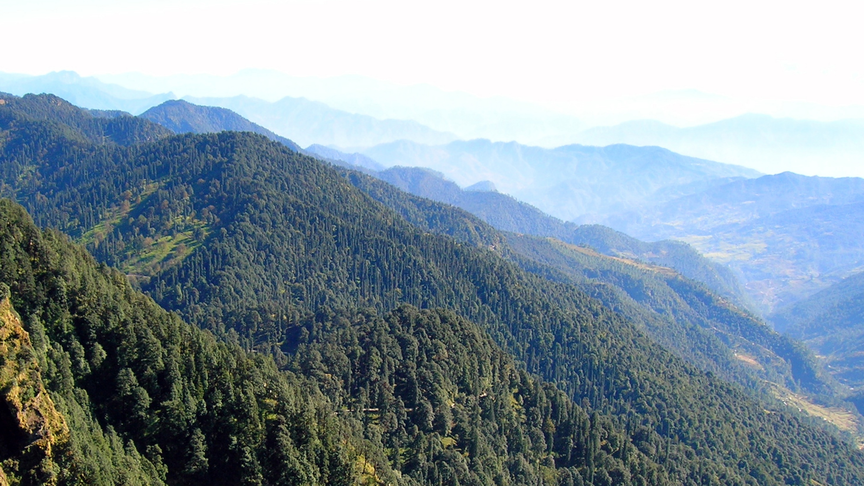

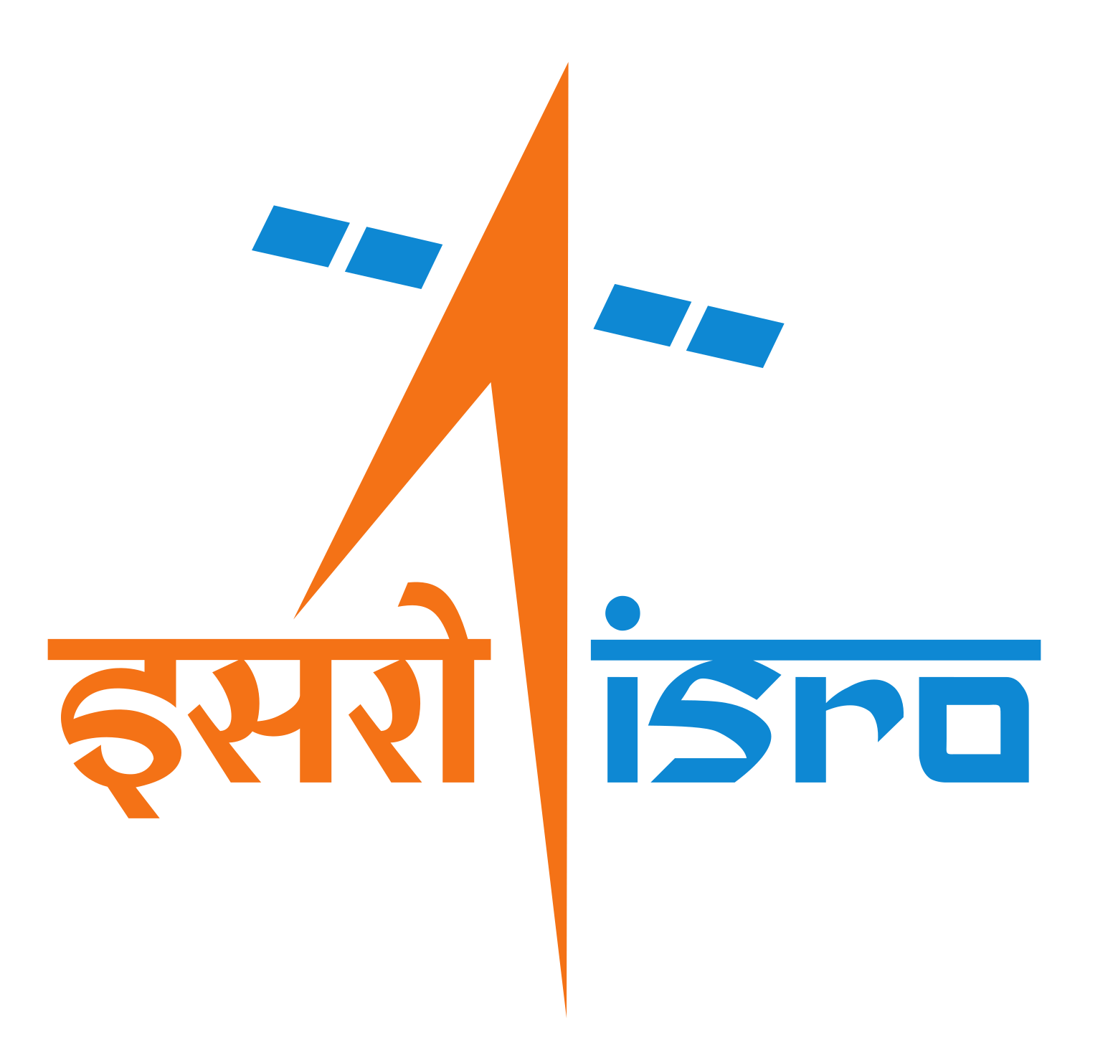
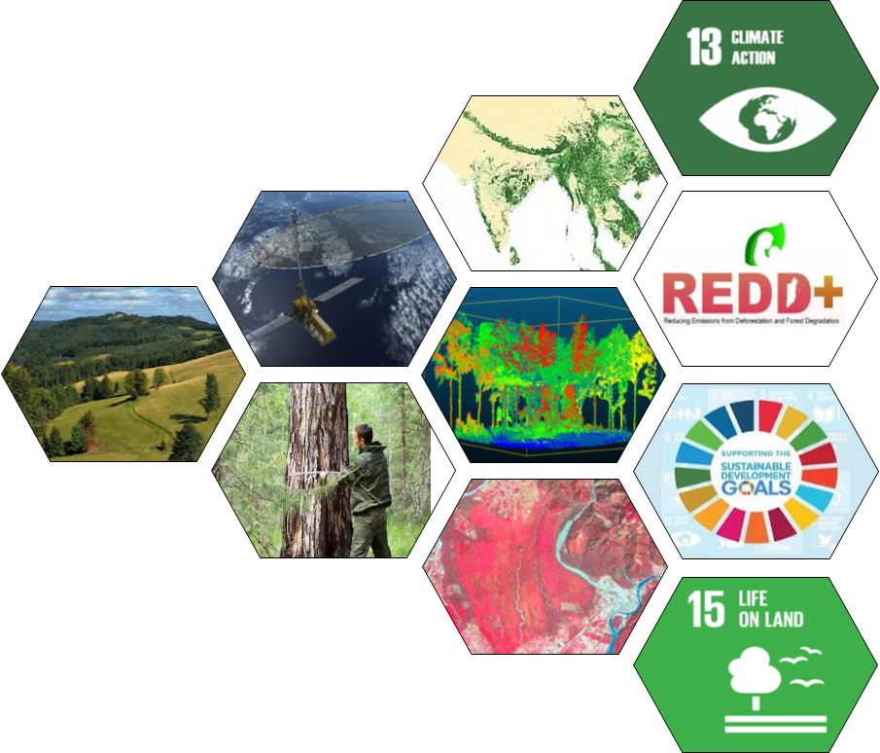
Training Course on
Earth Observation Data for Quantifying Forest Carbon Cycle
20-31 July, 2026
iirs
Forestry and Ecology Department
Agriculture, Forestry & Ecology Group
Indian Institute of Remote Sensing
Indian Space Research Organisation
Dept. of Space, Govt. of India
4 Kalidas Road, Dehradun, India https://www.iirs.gov.in/

Slide 2
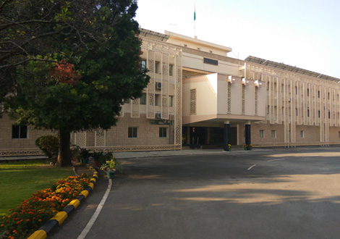
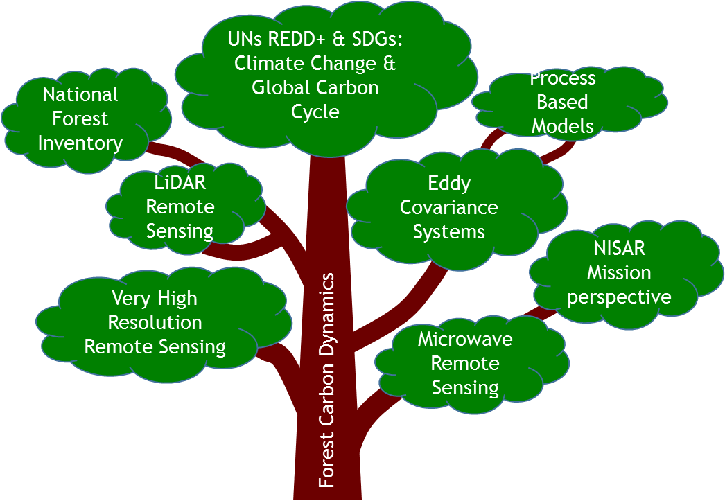


About IIRS
The Indian Institute of Remote Sensing (IIRS) - is a constituent unit of Indian Space Research Organisation (ISRO), Department of Space, Govt. of India. Since its establishment in 1966, IIRS is a key player for training and capacity building in geospatial technology and its applications through training, education and research in Southeast Asia. The training, education and capacity building programmes of the Institute are designed to meet the requirements of Professionals at working levels, fresh graduates, researchers, academia, and decision makers.
The Forestry and Ecology Department (FED), established in 1966, specializes in training and research on the application of aerospace remote sensing in forest resource assessment and management. Key areas of expertise include forest carbon cycle, biodiversity, imaging spectroscopy, SAR & LiDAR remote sensing, forest productivity, carbon and energy flux modelling, and cloud-based applications in forestry.
About This Course
Forests sequesters a large amount of carbon and play a crucial role in the global climate system. Quantification of forest biomass and carbon flux is, thus, vital for carbon budget accounting, carbon flux monitoring and for understanding the forest ecosystem response to climate change. Estimation of the forest biomass/carbon stocks is required in Reducing Emissions from Deforestation and Forest Degradation (REDD) programme and sustainable management of forest. Remotely sensed data integrated with forest inventories have become an effective approach to estimate forest biomass/carbon stocks and flux studies in combination with eddy covariance observations. The role of space technology has been clearly emphasized in mapping and monitoring applications in the context of United Nations REDD+ and Sustainable Development Goals (SDGs) target 15.2. With the development of new sensors, improved spatial, spectral, radiometric, and temporal resolutions, EO data can play a significant role in mapping and monitoring of forest biomass/carbon and carbon fluxes. Better data integration approaches are also required for accurate and spatially explicit estimations of carbon dynamics of forest ecosystem.
Course Highlight
This course aims to build a critical understanding among researchers, professionals, and academicians of the role of Earth Observation (EO) data in quantifying the forest carbon cycle. It is designed to equip participants with practical knowledge of EO-based methods for mapping and monitoring forest carbon stocks and fluxes through the integration of EO data, field observations, and modelling approaches. The two-week course includes expert lectures and demonstration sessions to support comprehensive, hands-on learning.
Eligibility and How to Apply
The course is intended for professionals, researchers, and students involved in forestry, conservation, vegetation ecology, environmental studies, geospatial technology, and ecological modelling. Preference will be given to candidates nominated by government organizations and professionals working in Remote Sensing and GIS applications in forestry and ecology. Interested and eligible candidates can apply through the IIRS website.
https://admissions.iirs.gov.in/coursecalender
Course Fee
Application fee: Rs. 500
Rs. 12,000/- (Rs. 4,000: Tuition Fee + Rs. 8,000: Registration & Other Charges).
Boarding and lodging will be provided at the IIRS Hostel, and the charges will be borne by the course participants.
Seats: 20 (all seats for Indian nationals only)
Last date for application: June 18, 2026 (17:30 Hrs. IST)
Announcement of selection list: June 23, 2026
Contact Details
For any further course-related queries, please contact:
Dr. Subrata Nandy Dr. Hitendra Padalia
(Course Coordinator) (Course Director)
nandy@iirs.gov.in hitendra@iirs.gov.in
+91-135-2524175 +91-135-2524170
Indian Institute of Remote Sensing (IIRS)
Indian Space Research Organisation (ISRO)
Department of Space, Government of India
4 Kalidas Road, Dehradun, India
https://www.iirs.gov.in/

